Slide 1


2025 Planned Giving Playbook

Slide 2
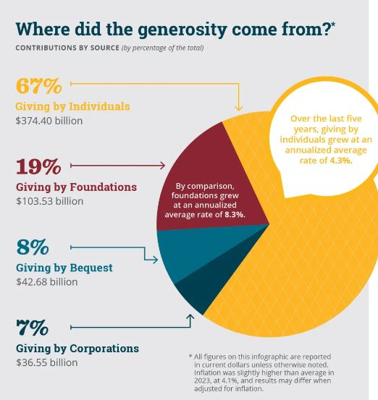

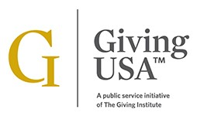

How Big is Planned Giving?
2023: $42.68 Billion
in Bequests

Slide 3
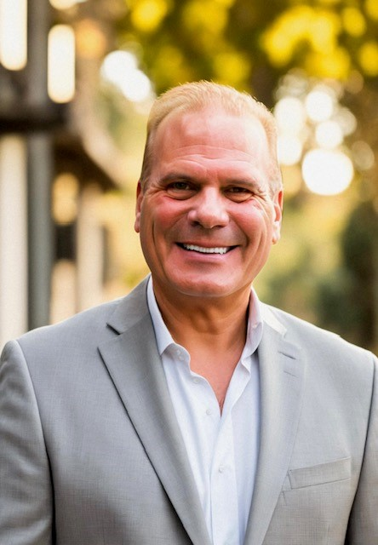

SAM YOUNG, DIRECTOR OF GIFT PLANNING
UNIVERSITY OF PENNSYLVANIA

Slide 4
WHY Planned Giving?
A record $5.57 billion was donated in 2023 (6.3 million every hour); Adjusted for inflation, funding down and fewer donors
A planned gift may be 25x annual giving and may increase annual giving
Legacy gifts turn the philanthropic faucet on, not off
Mega planned gifts are from people known to us, but may not be major donors (loyalty, not capacity)
Less than 3% of donors are engaged in a legacy conversation
Leverage philanthropy to bring unity to an uncertain world-solutions (Elections, Violence, Cts)
The Great Wealth Transfer is an opportunity for new gifts and new donors

Slide 5

What is Gift Planning?
Current and deferred gifts
Integrates charitable giving with your financial, tax, estate, and family plans
From simple options to more complex gift structures
Collaborate with your professional advisors
(cash or other assets)

Slide 6
Smart Ways to Give Now
Appreciated Securities –reduce or eliminate capital gains
The Penn Donor Advised Fund
Qualified Charitable Distribution (QCD, also called IRA Charitable Rollover); Min. age 70 ½
Financial as
sets: Private stock, private equity,
partnerships, cryptocurrency, etc.
Real Estate and Tangible Personal Property
Life Income Gifts Donate a minimum of
$10k and earn income for life

Slide 7

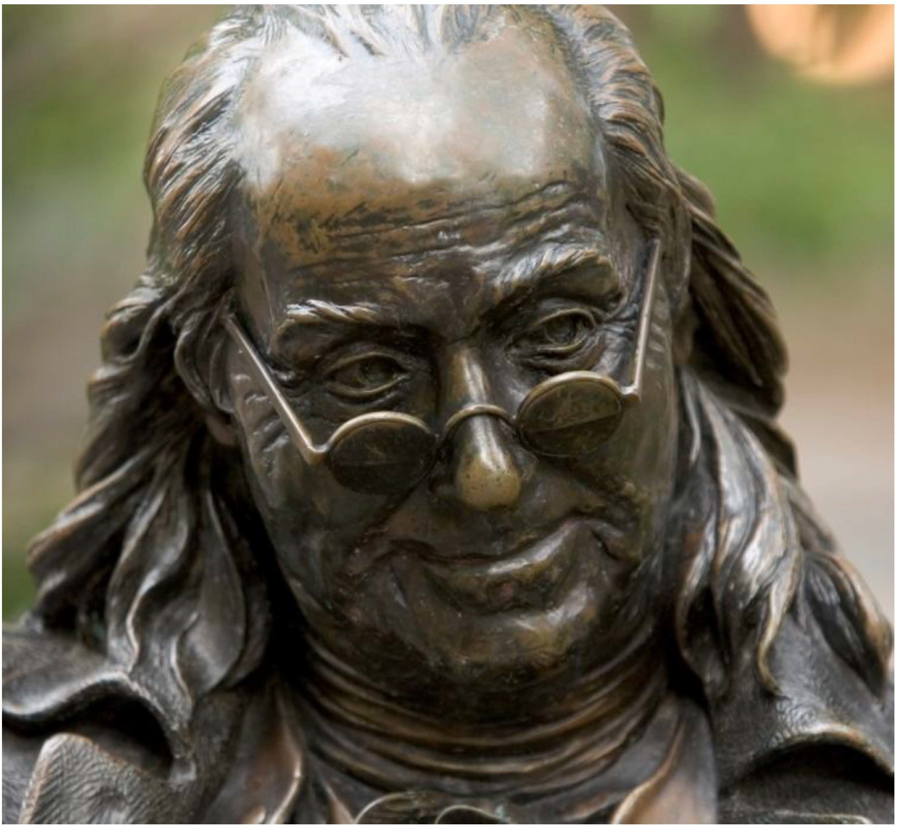
Everyone can make a bequest...
In this world nothing can be said to be certain, except for death and taxes. -Benjamin Franklin
Have you included Penn in your will?

Slide 8
Planned Giving Cues
Observe-Inquire-Not ask for $
Penn is important to me.
I want to do more, but this is all I can do this year.
A person talks about how they need more income in retirement (CGA/CRT).
No children/heirs.
Age reference.
Long-term donor at any level of giving-loyalty.
Alternative assets (boat/airplane/vacation home/art/cryptocurrency/NFT.
Sale of a residence.
Sale of a business.
Retirement.

Slide 9
Planned Giving Cues
Observe-Inquire-Not ask for $
11. Passing of a spouse or partner.
12. Mentions an IRA for tax-wise strategies (IRA/QCD/RMD).
13. A person is a long-time investor, and they talk about how they need to avoid long-term gains.
14. Stock market reference (appreciate securities)
15. Moving to a retirement community.
16. Existence of a DAF (D&C as the remainder beneficiary).
17. Mentions financial planning.

Slide 10
Life Insurance as a Charitable Gift
Naming Penn as a beneficiary of your life insurance policy is one of the easiest ways to make music your legacy.
Beneficiaries are the individuals and organizations that are most important to you, like Penn.
Life Insurance Policies
Many policies allow for multiple beneficiaries, so you can easily donate the entirety or a portion of the policy to Penn.
Contact your life insurance provider to designate Penn as a beneficiary today! Plus, many providers allow you to make these changes online anytime.

Slide 11
Qualified Charitable Distributions
Eligible the calendar you turn 70 ½ years of age
Required minimum distribution begins at 73
Stretch IRA has been eliminated
Strategy to replace the stretch IRA = testamentary CRT

Slide 12
What is a Stretch IRA?
The 2019 SECURE Act eliminated the “stretch” IRA, which previously allowed inheritors of IRAs to take taxable distributions (and make related tax payments) over the inheritor’s life expectancy
After January 1, 2020, inheritors of IRAs can no longer stretch distributions, they must withdraw all assets from the inherited account within 10 years, thus accelerating taxation

Slide 13
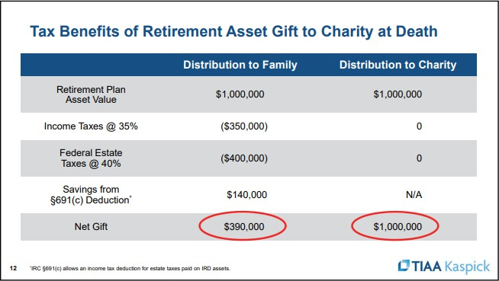
Tax Benefits of Retirement Asset Gift to Charity at Death

Slide 14
Federal Estate Tax Exemption
2025-$13.99 M per person
On January 1, 2026, the current provision sunsets and reverts to $5.6 M for individuals unless Congress extends it.
Strategies:
Penn Impact Annuity Beneficiary Designations Testamentary CRT

Slide 15
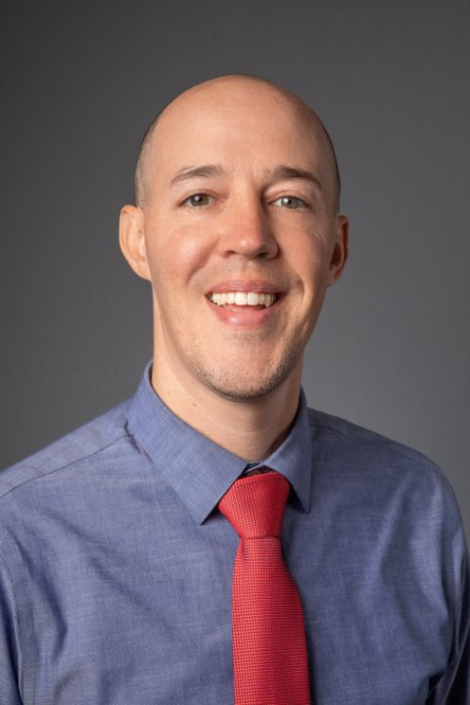

BRYAN NEMETH, SENIOR DIRECTOR
RUTGERS UNIVERSITY FOUNDATION

Slide 16
Gift Planning Marketing:
Practical Insights for All Sizes
Role at Rutgers
Scope of team/resources
Insights applicable to both large and small organizations
Consistency and Creativity

Slide 17
Why Marketing Matters in
Gift Planning
Educates donors and normalizes legacy conversations
Builds pipeline of future gifts
Opens the door for donor engagement

Slide 18
Marketing vs. Relying on
Frontline Fundraisers Alone
Marketing creates awareness and generates leads
Supports fundraisers in prioritizing warm prospects
Increases efficiency and scalability of outreach

Slide 19
Rutgers Strategies:
Multi-Channel Campaigns
Marketing Principles: clean, clear, concise, and avoid redundancy
Partner with external vendors
Direct mail
Digital ads
Email journeys
Donor stories

Slide 20
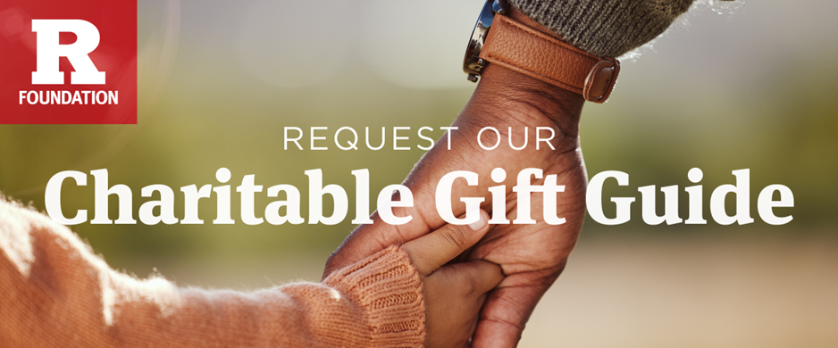
As you plan your charitable contributions for the year ahead, consider how strategic gift planning can maximize your impact. Our free Charitable Giving Guide highlights how you can:
Maximize Tax Benefits: Reduce tax liabilities, including capital gains and estate taxes, while supporting causes you care about.
Generate Lifetime Income: Certain giving options can provide income for you or your loved ones.
Think Creatively: Go beyond cash donations with innovative strategies tailored to your goals.

Slide 21
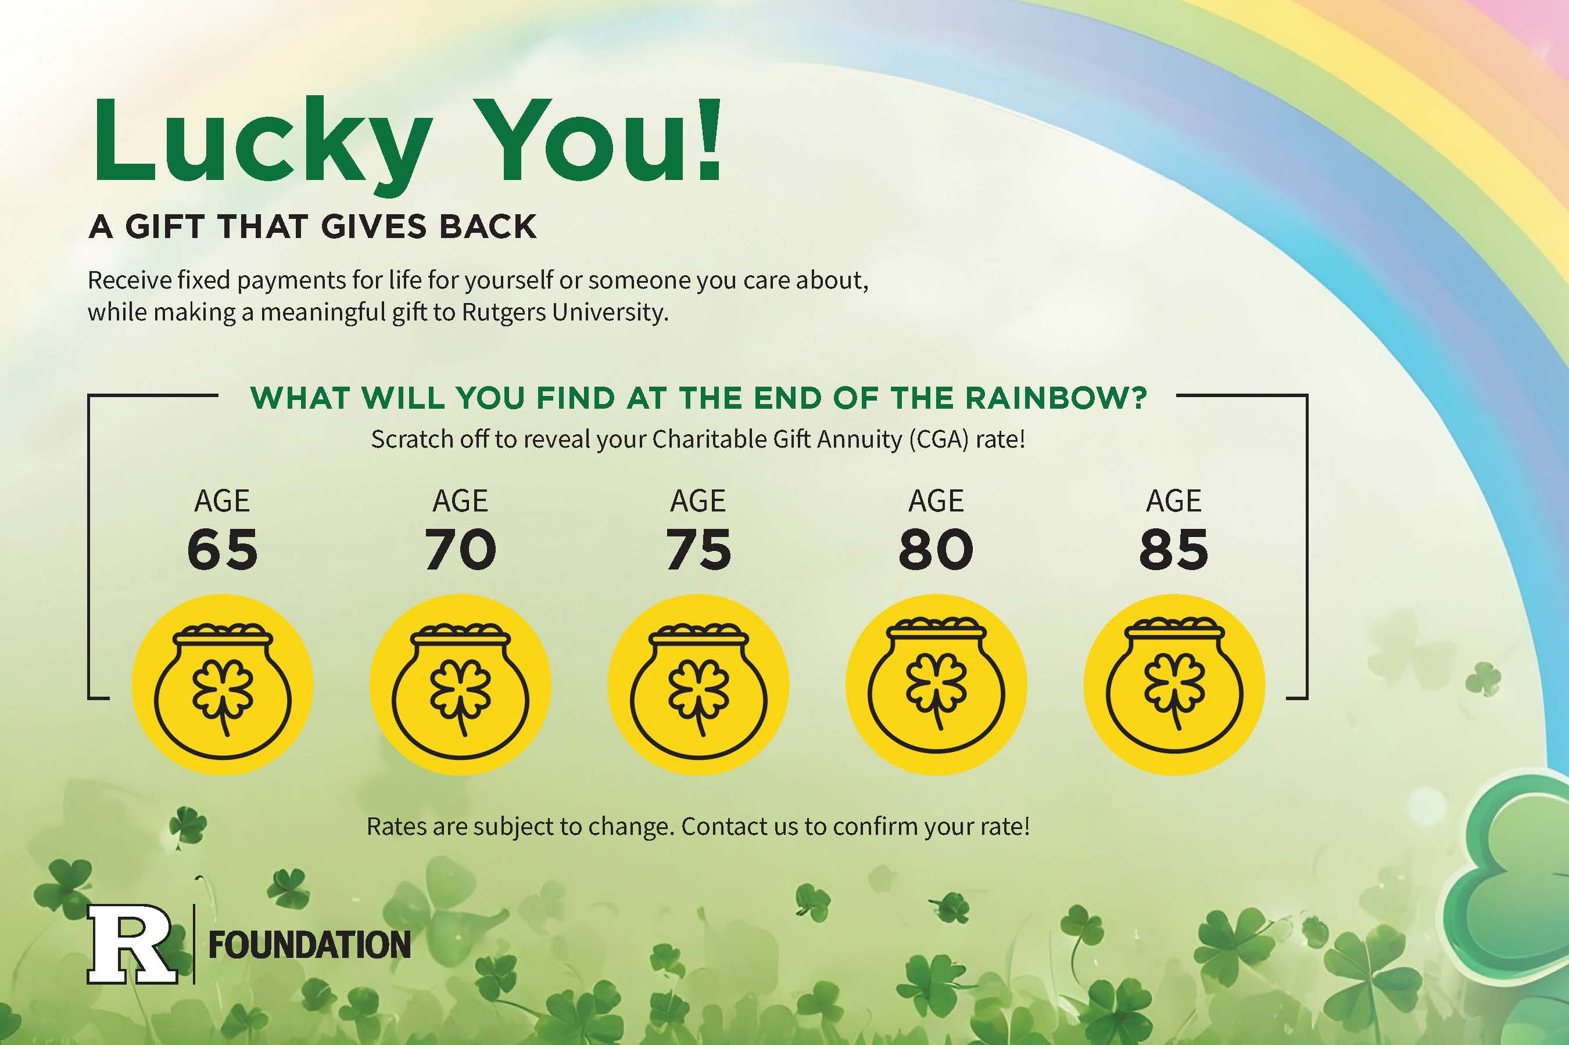

Slide 22
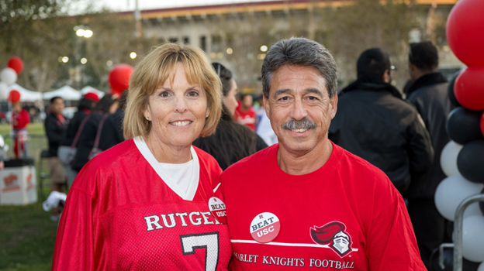
Dear William,
At Rutgers University, we are inspired by stories of alumni and supporters who are dedicated to contributing to the communities and organizations that have enriched their lives. One such story is that of Stuart Slamowitz RC’84 and his wife, Debbie.
Stuart, the first in his family to go to college, credits Rutgers with helping him “grow up.” His time here was transformative, allowing him to discover his passion for medicine, connect with mentors, and build a foundation for his future. Today, Stuart and Debbie have included Rutgers in their estate plans, creating two endowed scholarships that reflect their gratitude and desire to support future students:
“The impact each and every one of us can provide is tremendous. I say, find passions that have enriched your lives and provide support as much as possible. You never know when your last day is.”

Slide 23
Internal Marketing Matters Too
Helps fundraisers and leadership understand value
Start by sharing external communications
Annual Training for frontline fundraisers
Partner with Annual Giving and individual schools/units on campus to increase messaging opportunities

Slide 24
Cost-Effective Marketing for
Small Shops
Free online tools (Mail Chimp, ChatGPT, Google Sites)
Utilize your NJCGP network
Handwritten notes
Buck slips included with acknowledgments

Slide 25
Common Mistakes to Avoid
Technical jargon or overly complex messaging
Infrequent or inconsistent outreach
Focusing on the mission/tax advantages
Lack of follow-up or process

Slide 26
Getting Started with Marketing
Add a legacy message or donor testimonial to your website
Launch an email with a donor quote
Utilize your signature block to include a message that links back to your webpage

Slide 27

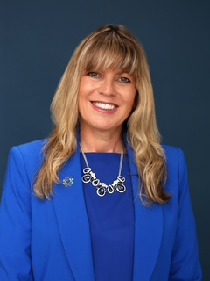
JACKIE BARTLEY, JD, VICE PRESIDENT
HACKENSACK MERIDIAN HEALTH

Slide 28
GIFT PLANNING:
STORIES OF IMPACT
Every gift tells a story.
Once upon a time, there was a donor who loved their local hospital…

Slide 29
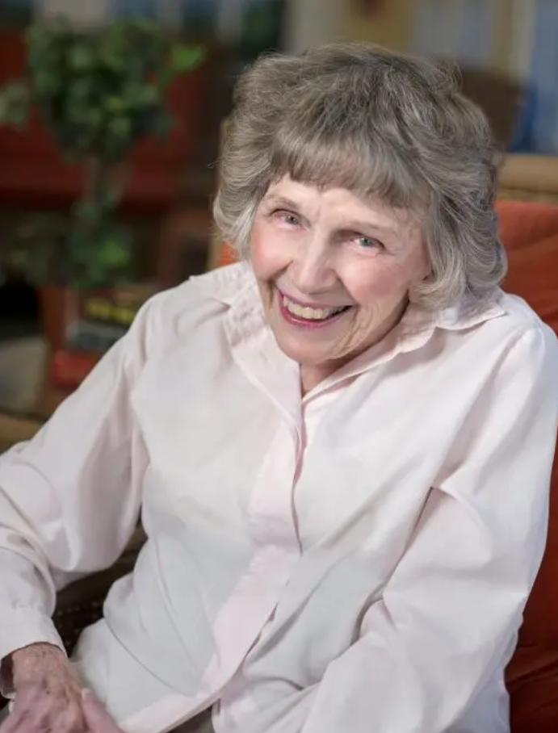
CHAPTER 1: A Vision to Impact Vision (Literally!) in her Community
Main Character: Janice Mitchell Vassar
“An extraordinary woman who honored her family’s legacy of philanthropy…through so many kind deeds and good works of her own. Her personal legacy will be strongly tied to the phenomenal changes and bright future at Bayshore Community Hospital.” ~ John K. Lloyd, former CEO Meridian Health

Slide 30
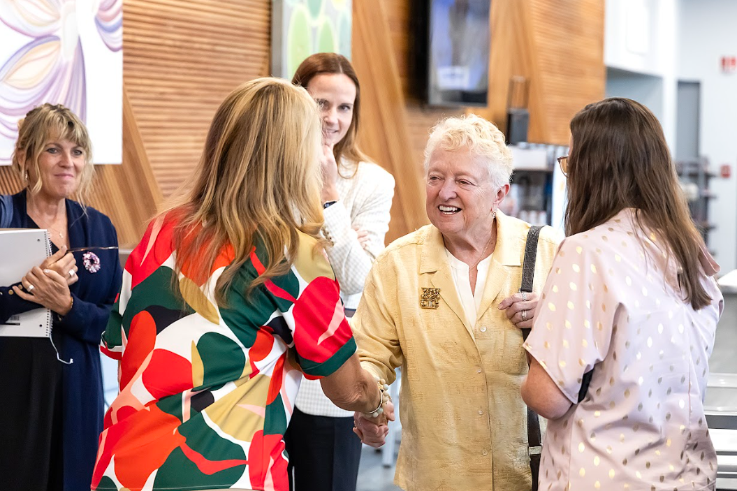
CHAPTER 1: A Vision to Impact Vision (Literally!) in her Community
Supporting Characters:
Hospital nursing team and staff
Hospital leadership
Attorney of record
Executor
Former board member who is also
an estate planning attorney
HMH Foundation
Office of Gift Planning

Slide 31
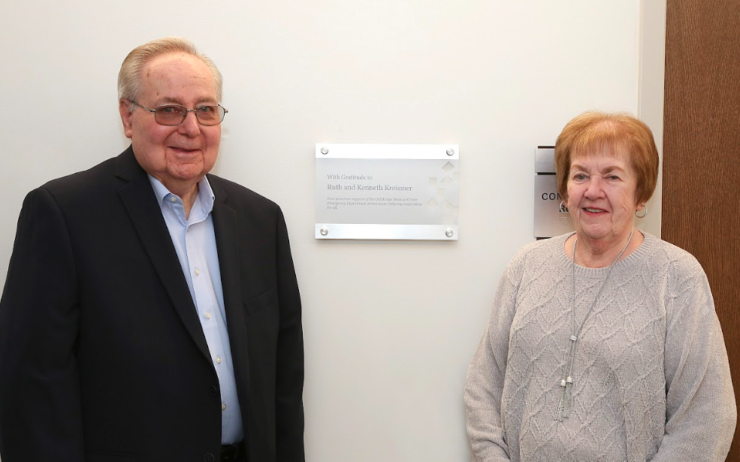
CHAPTER 2: Uncovering Passions Through Surveys
Main Characters: Ken & Ruth Kreismer
Loyal annual giving donors
Grateful for care they received from the cardiac care and physical therapy departments at two of our hospitals
“Our belief was if we appreciate these hospitals, we should help them, including through our estate plan.”

Slide 32
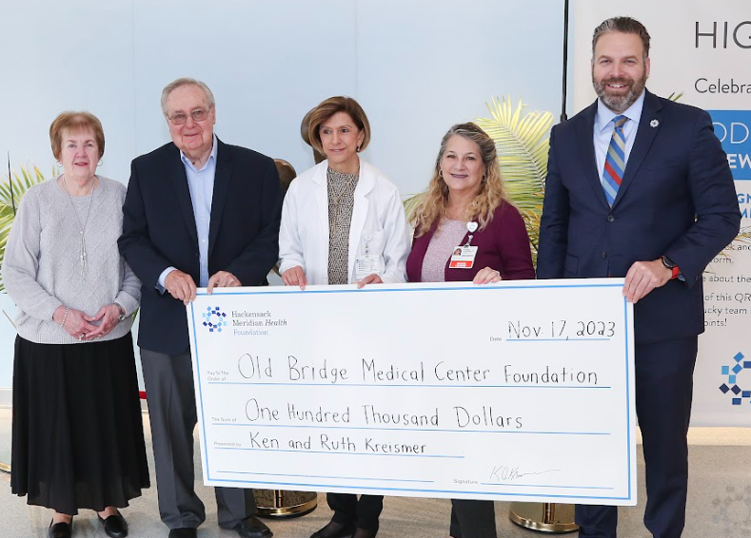
CHAPTER 2: Uncovering Passions Through Surveys
Supporting Characters:
Stelter survey
Physician and clinical teams
Professional advisor
HMH Foundation
Office of Gift Planning

Slide 33
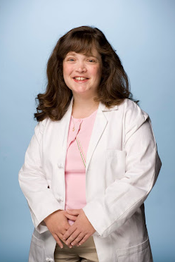
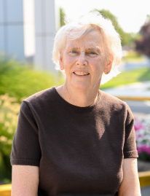
CHAPTER 3: Paying it Forward
Main Character: Dr. Janet L. Schairer
“My students are like family to me. I would like some of my colleagues, and even some of my patients to be inspired to get the same idea.”
Main Character: Dr. Eileen Masterson
“I wanted to do something that would benefit residents at Jersey Shore University Medical Center, since I know many of them have a large student debt at a time when they are also supporting growing families.”

Slide 34
CHAPTER 3: Paying it Forward
Supporting Characters:
Medical students
Mentors (Dr. Kountz and Dr. Schairer’s father)
Past donors as philanthropic influencers
Professional advisors
Hospital team and leadership

Slide 35
CHAPTER 4: The Right Conversations Matter
Main Character: Russell Wanot
Long-standing connection with Southern Ocean Medical Center over the years.
Impressed by the medical center’s progressive, cutting-edge approach to delivering top-notch care.
“My goal is to make a gift that benefits humanity,” Russ says. “It makes me happy to think that I can help make someone’s life easier or better because they were able to get excellent care.”
In his estate planning journey, Russ prioritized reaching out to the Office of Gift Planning at Hackensack Meridian Health.
Conversation led to Russ directing through a bequest in his will that the proceeds from the sale of his home will ultimately support the hospital.

Slide 36
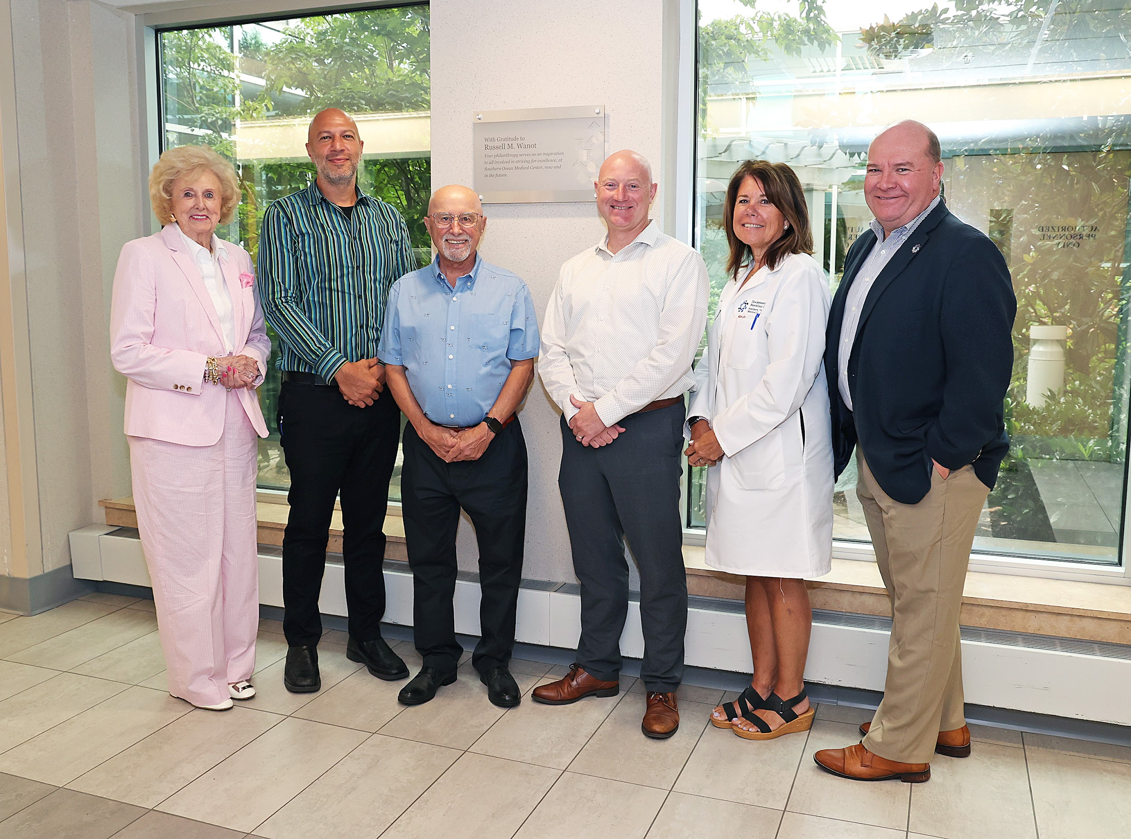
CHAPTER 4: The Right Conversations Matter
Supporting Characters:
Board Member
Chief Hospital Executive
Other Hospital Leadership
Care team
HMH Foundation
Office of Gift Planning

Slide 37
Key Takeaways from the
2025 Planned Giving Playbook
Develop and foster relationships with professional advisors.
Keep it simple: Use genuine conversations to uncover donor passions and lead to bequest/beneficiary discussions.
Be proactive: Let donors/advisors know you can accept alternative assets and guide the process.
Explore blended gifts: Combine current/deferred gifts using multiple asset types.
Marketing consistency is vital. It is not one-and-done.
Budget doesn't define success—creativity and storytelling do.

Slide 38
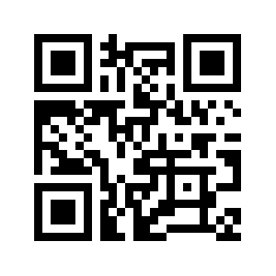
Become a Member Today!
Receive a discount for Planned Giving Day on June 5th.

